Slide 1
A WEB-BASED INTERNET VOTING APPLICATION FOR CRAWFORD UNIVERSITY USING PHP
SHOLADIRAN MICHAEL OLASUNKANMI
SUPERVISED BY:
MR. IKUDAISI DAVID

Slide 2
PRESENTATION OUTLINE
Introduction
Literature review
Statement of problem
Aim and objectives of research
Research methodology
Proposal model
Contribution to knowledge
Conclusion
References

Slide 3
INTRODUCTION
Cardiovascular disease (CVD) in medical science is known has one of the deadliest human diseases in the world. This deadly diseases occurred when human heart is unable to drive the essential amount of blood to other parts of the body to fulfil the normal function of the body as shown in figure 1.0 (Ambale et al., 2017)
Some of cardiovascular heart disease symptoms include
- imbalance breathing
- body weakness
- fatigue with associated signs

Slide 4
INTRODUCTION
Base on annual report form WHO (World Health Organization), this body gives an assessments that
in 2015:
- 30% of deaths in the world was due to CVD, leading to more than 17 million deaths
Executive director, Nigerian heart federation (NHF), Dr. Kingsley Akinroye, proclaim that the rate of heart diseases is worryingly going up in Nigeria. This, he said is as a result of low awareness drive and poor health-care institutions across the nation which has led to death of many Nigerians (Guardian Newspaper, Nigeria.2019).

Slide 5
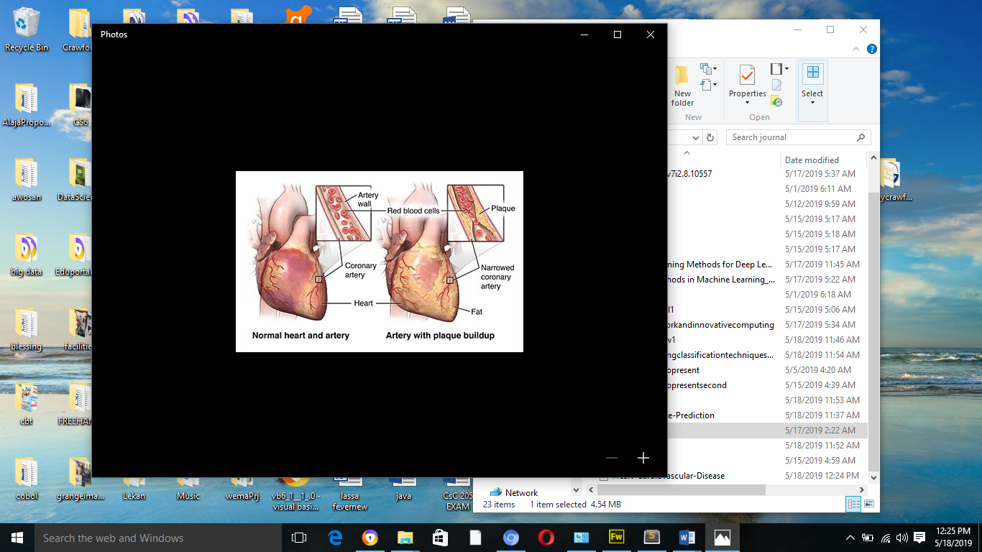
INTRODUCTION
Figure 1.0: Image showing a human heart with cardiovascular diseases (Google heart diseases medical image)

Slide 6
INTRODUCTION
Today some of this data collected includes few of the risk factors contributing to the overwhelming rate of cardiovascular diseases in Nigeria which includes the following:
- Family history of cardiovascular disease
- High levels of cholesterol
- Uncontrolled high blood pressure
- Ethnicity
- Smoking
- Not being physically active (Exercise)
- High-fat diet
- Uncontrolled diabetes
- Chronic stress or depression
- Increasing in age
- Obesity

Slide 7
INTRODUCTION
In recent there are many research that has been carried out by researchers using different machine learning, deep learning, and ensembles.
The research intends to provide solution in cardiovascular diseases risk prediction and monitoring using Smote Ensemble Machine Learning Algorithm and Health Monitoring as a service.

Slide 8
LITERATURE REVIEW
Author and Year | Title and Source | Contribution | Problem observed
Kusuma, S., & Divya, U. 2018 | Machine Learning and Deep Learning Methods in Heart Disease (HD) Research. International Journal of Pure and Applied Mathematics, Vol. 119, Issue 18, pp. 1483-1495. | In this research 60% of people were characterized by machine learning techniques and support vector machines and 30% by deep learning approaches. | use of weak classifier
Haq, A. U., Li, J. P., Memon, M. H., Nazir, S., & Sun, R 2018 | Hybrid Intelligent System Framework for the Prediction of Heart Disease using Machine Learning Algorithms. Mobile Information Systems Volume 2018, Article ID 3860146, 21 pages | The proposed machine-learning-based decision support system will assist the doctors to diagnosis heart patients eﬃciently. | It combine machine learning with selection algorithm but failed to check data imbalance data

Slide 9
Author and Year | Title and Source | Contribution | Problem observed
Duke Hee Lee & Ahmed Rabi 2012 | Development of a Mobile Phone Based e-Health Monitoring Application. International Journal of Advanced Computer Science and Applications, Vol. 3, No. 3. | This system consists of the following sub-systems: real-time signal receiver, ECG signal processing, signal display in mobile phone, and data management as well five user interface screens. | Cost of managing and maintaining software. Time delays.
Khan, Y., Qamar, U., Yousaf, N., & Khan, A. 2019 | Machine Learning Techniques for Heart Disease Datasets: A Survey. Proceedings of the 2019 11th International Conference on Machine Learning and Computing - ICMLC ’19 | This research study different machine learning in medical domains, particularly on heart disease datasets. The survey finds out that the most popular classification techniques are Support Vector Machine, Neural Networks, and ensemble classifiers. | Weak classifier and the essemble classifier used was with imbalance data

Slide 10
PROBLEM STATEMENT
Cardiovascular disease (CVD) remains the leading cause of sickness and mortality in the world. Different areas of IT (Information Technology) has been explored to help in reducing the percentage of number of mortality recorded every year from this deadly diseases across the world. In recent time one of the most used approach to predict and detect present of cardiovascular diseases in human is the use of conventional supervised learning algorithm such as Support Vector Machines (SVM), K-Nearest Neighbor (KNN), Artificial Neural Network (ANN), Naïve Bayes, Decision Trees (DT), Random Forest (RF) and Rotation Tree (RT) which are weak classifier and provide unreliable predictive accuracy result.

Slide 11
PROBLEM STATEMENT
Another major problem is the use of imbalance data set which has made most prediction result erroneous. In most cases patient with this deadly diseases died because of improper or no health monitoring facilities put in place and quick health challenge solution response. As a solution to this problem, this research propose a framework to predict and monitor patients with cardiovascular diseases using SMOTE Ensemble.

Slide 12
AIM AND OBJECTIVES
The aim of this study is to Develop a MODEL FOR CARDIOVASCULAR HEART DISEASE RISK PREDICTION USING SMOTE ENSEMBLE
.
These are the specific objectives:
i. To develop a model to predict cardiovascular heart disease using SEMLA
ii. To implement the proposed model
iii. To evaluate the proposed model against the existing model.

Slide 13
RESEARCH METHODOLOGY
Step1: Input disease datasets (cardiovascular diseases dataset from UCH)
Step2: Select the attributes of disease datasets.
Step3: Pre-processing of all attributes by applying filter (add classification zeroR classifier) on the attributes using WEKA data mining tool.
Step 4: Apply SMOTE algorithm on dataset (to remove dataset imbalance)
Step 5: Visualize all the attributes of disease dataset.
Step 6: Train the dataset using different ensemble machine learning techniques using 10-fold cross validation with 66% percentage splitting.

Slide 14
RESEARCH METHODOLOGY
Step 7 : Carry out performance evaluation of each of the ensemble machine learning (predictive accuracy)
Step 8: Select the ensemble machine learning with the best predictive accuracy
Step 9: Supply the test data set
Step 10: Carry out the prediction analysis using the new smote ensemble machine learning model
Step 11: Result discussion and presentation (Result visualization i.e patient classification)
Step 12: Create a Health Monitoring Cloud service for patient with risk of cardiovascular heart diseases.
Step 13: Generate regular report from app which is then transfer to the doctor.

Slide 15
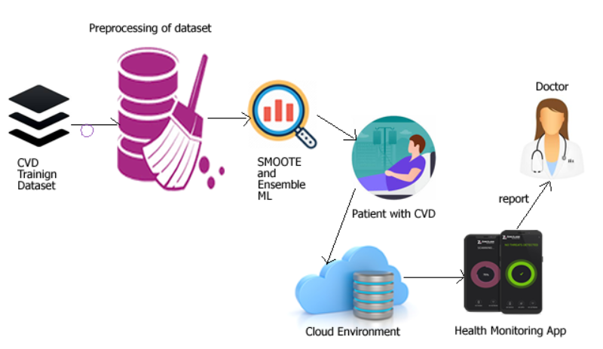
RESEARCH PROPOSAL MODEL
After a careful study in this research we proposed a model as shown in figure 2.0 which shown how various research activities and tools are connected.
Figure 2.0: Proposed framework showing using SMOOTE ensemble machine learning with Health Monitoring cloud service

Slide 16
CONTRIBUTIONS TO KNOWLEDGE
Based on our literature review and deep research on various machine learning algorithm used in predicting risk of having cardiovascular heart diseases we hope to improve on this area of research using SMOTE ensemble machine learning algorithm which is better than a conventional weak machine learning algorithm in terms of predictive accuracy, TP rate, FP rate, precision, recall, F-measure and ROC area with application of cloud computing for patient health monitoring.

Slide 17
CONCLUSION
In this research study,a framework for Cardiovascular Heart Disease Risk Prediction and Monitoring using SMOTE Ensemble Machine Learning Approach and Health Monitoring as a Service was proposed for predicting risk of having cardiovascular heart disease. The 10-fold cross-validation method was used in the system for validation. In order to check the performance of each of the ensemble machine learning classifier and also different evaluation metrics will also be adopted. A new predictive model will be use to classifier the test data set. This research also proposed the use of health monitoring service for patient diagonize with the risk of having cardiovascular heart diseases using cloud facilities.

Slide 18
REFERENCES
[1]. Ambale-Venkatesh, B., Yang, X., Wu, C. O., Liu, K., Hundley, W. G., McClelland, R., Lima, J. A. C. (2017). Cardiovascular Event Prediction by Machine Learning Novelty and Significance. Circulation Research, 121(9), 1092–1101 .
[2]. Alaa, A. M., Bolton, T., Di Angelantonio, E., Rudd, J. H. F., & van der Schaar, M. (2019). Cardiovascular disease risk prediction using automated machine learning: A prospective study of 423,604 UK Biobank participants. PLOS ONE, 14(5), e0213653.
[3]. Elgazzar, K., Aboelfotoh, M., Martin, P., & Hassanein, H. S. (2012). Ubiquitous Health Monitoring Using Mobile Web Services. Procedia Computer Science, 10, 332–339.
[4]. Hibatullah, A.(2016). A Brief Survey of Cloud Computing, Global Journal of Computer Science and Technology, Vol. 16, Issue 3, pp. 23-32.

Slide 19
REFERENCES
[5].Haq, A. U., Li, J. P., Memon, M. H., Nazir, S., & Sun, R. (2018). A Hybrid Intelligent System Framework for the Prediction of Heart Disease Using Machine Learning Algorithms. Mobile Information Systems, 2018, 1–21.
[6].Mohsin, N.(2012). Cloud Computing: Overview & Current Research Challenges, Journal of Computer Engineering, Vol. 8 ,Issue 1 , pp. 14-22.
[7]. Kusuma, S., & Divya, U.(2018). Machine Learning and Deep Learning Methods in Heart Disease (HD) Research, International Journal of Pure and Applied Mathematics, Vol. 119, Issue 18, pp. 1483-1495.
[8]. Khan, Y., Qamar, U., Yousaf, N., & Khan, A. (2019). Machine Learning Techniques for Heart Disease Datasets. Proceedings of the 2019 11th International Conference on Machine Learning and Computing - ICMLC ’19.

Slide 20
THANK YOU FOR LISTENING

